Slide 1
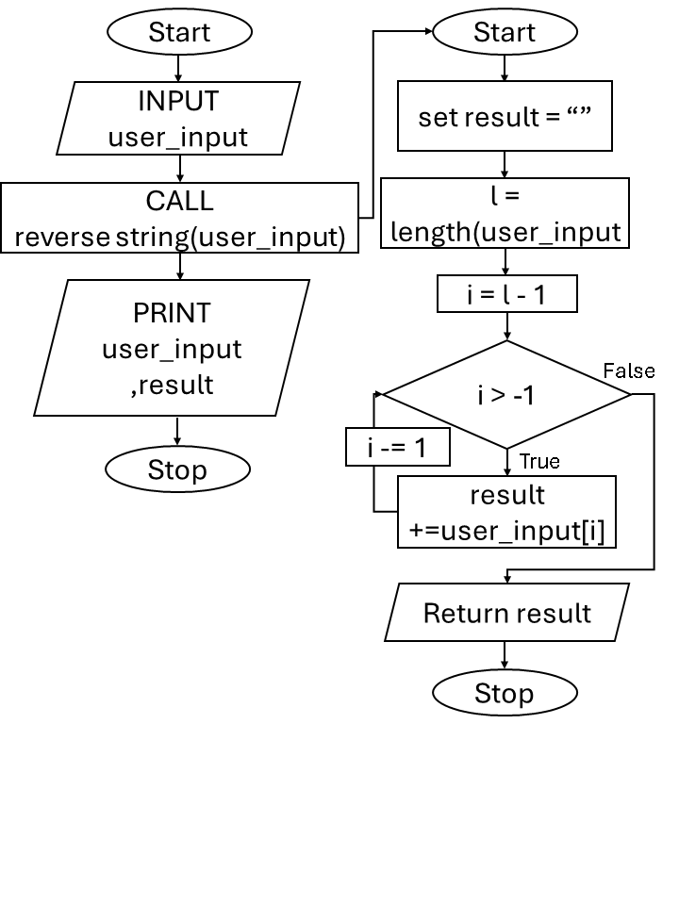
Experiment 10
10.1.2 Reverse String
Algorithm :
Step 1 : Start
Step 2 : Input string and store in user_string
Step 3 : Set result as an empty string
Step 4 : Find length of user_string and store in l
Step 5 : Set i = l - 1
Step 6 : Repeat steps while i is greater than or equal to 0
Step 7 : Get the character at index i from user_string
Step 8 : Add the character to result
Step 9 : Decrease i by 1
Step 10 : Go back to Step 6
Step 11 : Print result
Step 12 : Stop
Flowchart :

Slide 2
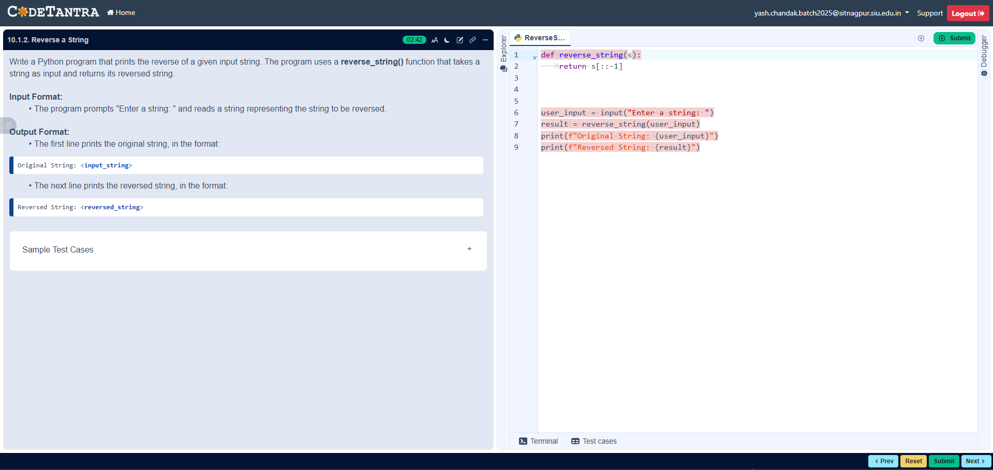
Code :
def reverse_string(user_string): result=""
l=len(user_string)
for i in range (l-1,-1,-1):
result += user_string[i]
return result
user_input = input("Enter a string: ")
result=reverse_string(user_input)
print(f"Original String: {user_input}")
print(f"Reversed String: {result}")
Execution :

